Slide 1
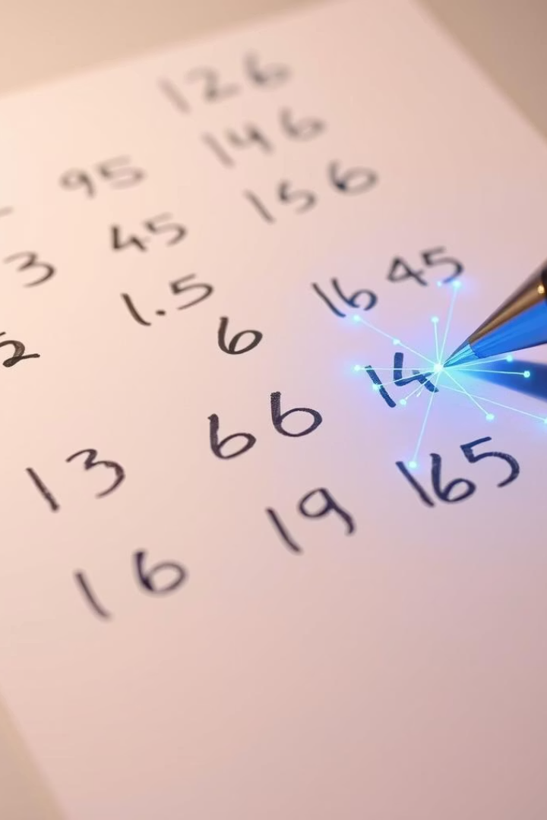
Introduction to Handwritten Digit Recognition
"Turning handwriting into smart digital insight."

Slide 2
Group Members
Nuha Rahman
Sabrina Binte Rahim
Asma Sadia Tarisha
(011221411)
(011221244)
(011213129)

Slide 3
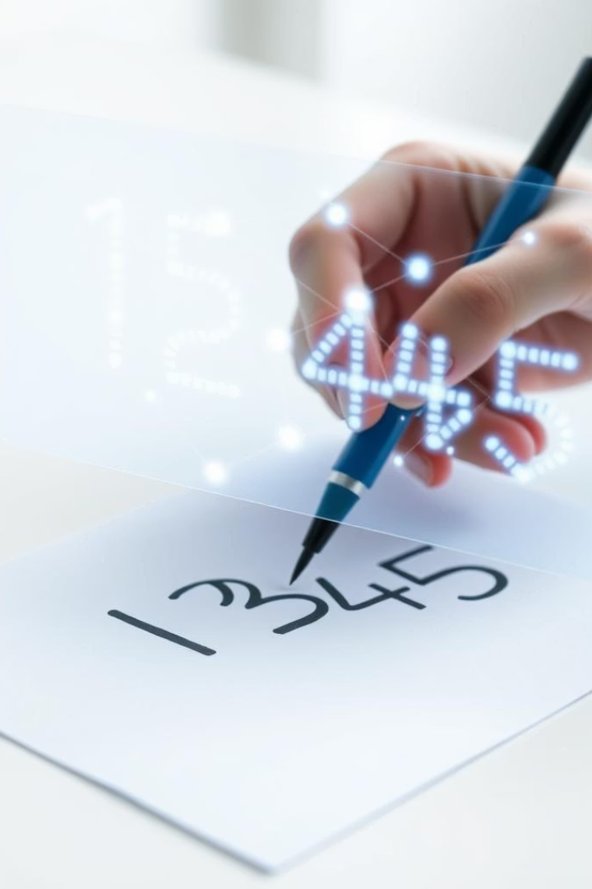
The Problem:
Manual Data Entry
Handwriting Variability: Each person's handwriting is unique, posing a challenge for computers.
AI Learning: The system learns to classify digits accurately, even messy or unusual ones.

Slide 4
Project Overview: Automated Digit Recognition
Dataset:
MNIST with 60,000 training and 10,000 test images.
Model:
CNN built using TensorFlow and Keras.

Slide 5
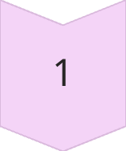
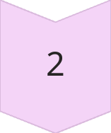
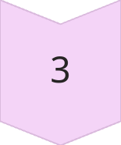
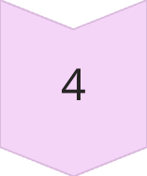
AI Features
Learning patterns from handwritten images
Automatically understanding important features
Generalizing to new handwriting styles
Alphabet recognition

Slide 6
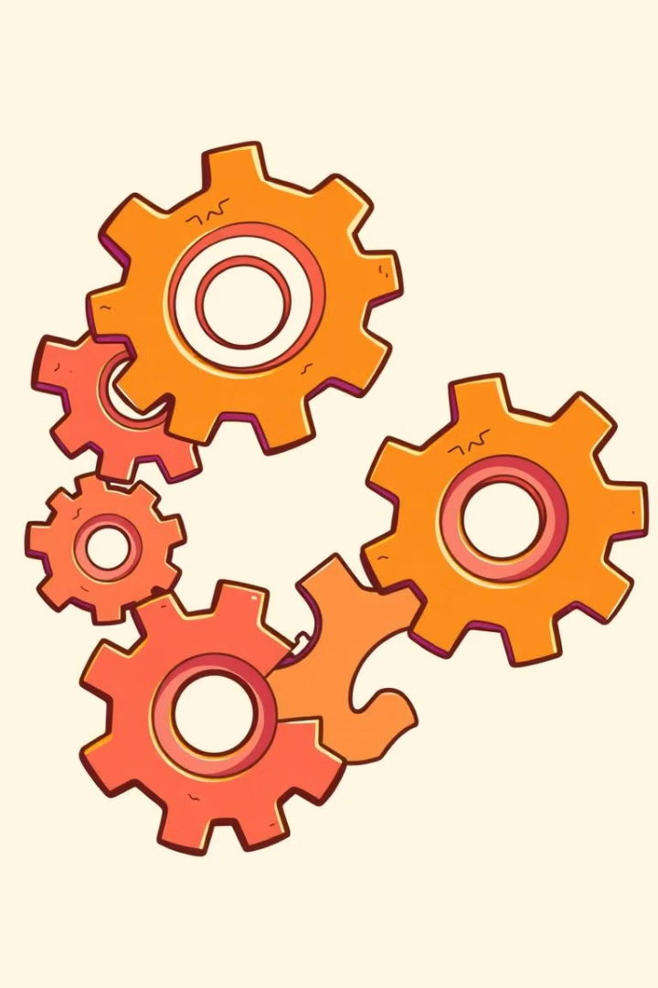
Technical Details: Implementation
Libraries Used
TensorFlow
Keras
OpenCV for drawing interface.

Slide 7
Proposal 2 :
AI-Generated Quiz Maker

Slide 8
AI-Generated Quiz Maker
AI Quiz Maker is a smart tool that uses artificial intelligence to automatically generate and manage quizzes. It supports various question types, offers answer explanations, and helps both teachers and students with efficient learning and assessment.

Slide 9
Features
AI-Powered Question Generation
Multiple Question Types (MCQ, True/False, etc.)
Difficulty Level & Topic Selection
Smart Quiz Creation & Suggestions
User Authentication (Teacher/Student Roles)
Quiz Modes: Practice, Timed, Exam
Result Analysis & Performance Tracking
Export Quiz (PDF, Word)

Slide 10
Benefits
Time-Saving
Customizable
Consistent
Enhances Learning
Scalable
Portfolio Value
Future-Ready

Slide 11

Thank You !

